Slide 1
Bias – Variance & Linear Models

Slide 2
Calculus Recap
Given a function, what does the derivative say ??
How to minimize a function ?
2 important approaches : (i) Closed form (ii) Iterative
What is constrained ? Unconstrained minimization ?
Notes:
Welcome to the lecture on ””
1

Slide 3
Examples
Say, we want to minimize
y = 4x² + 2
Plot the function :
dy/dx = 8x
Put dy/dx = 0 , it implies x = 0
So function is minimum at x = 0
This is the closed form solution

Slide 4
Examples
Say, we want to minimize
y = 4(x-5)² + 2
Plot the function :
dy/dx = 8(x-5)
Put dy/dx = 0 , it implies x = 5
So function is minimum at x = 5
This is the closed form solution

Slide 5
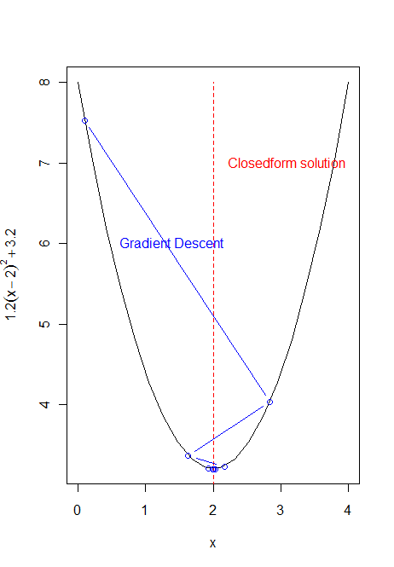
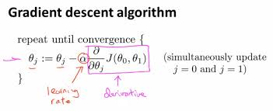
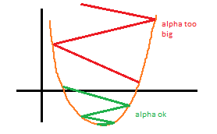
Iterative minimization
1

Slide 6
Iterative Minimization
y = 4(x-5)² + 2
dy/dx = 8(x-5)
Say x_old = 4
X_new = x_old - α(dy/dx)|at x = x_old
Iter 1 : X_new = 4 - 0.1(8*(4-5)) = 4 + 0.8 = 4.8
Iter 2 : X_new = 4.8 - 0.1(8*(4.8-5)) = 4.8+0.16 = 4.96

Slide 7
Quick exercise
E = 1.2(x-2)² +3.2
x_{opt} = 2
Work out the closed-form solution
Work out x⁽¹⁾, x⁽²⁾ results of two steps of gradient descent
Check the Impact of different Learning Rates,
Try 0.1, 0.001, 0.5
1

Slide 8
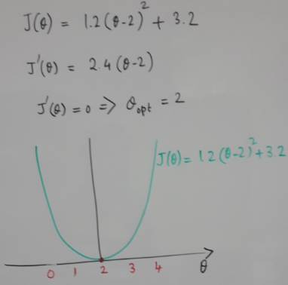
Function Minimization
CLOSED FORM

Slide 9
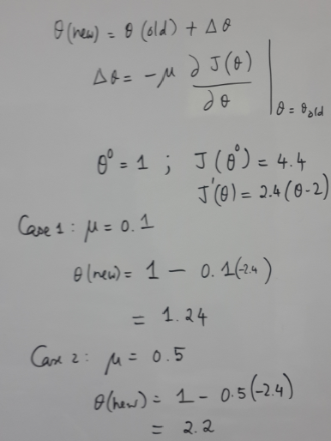
Iterative method
GRADIENT DESCENT

Slide 10
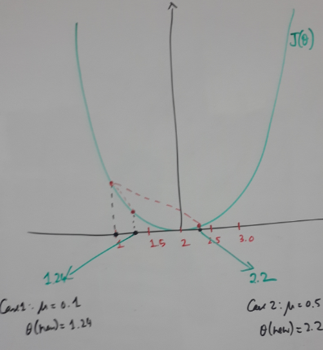
Gradient Descent
Impact of Learning Rate
GRADIENT DESCENT

Slide 12
Simple Vs Complex

Slide 13
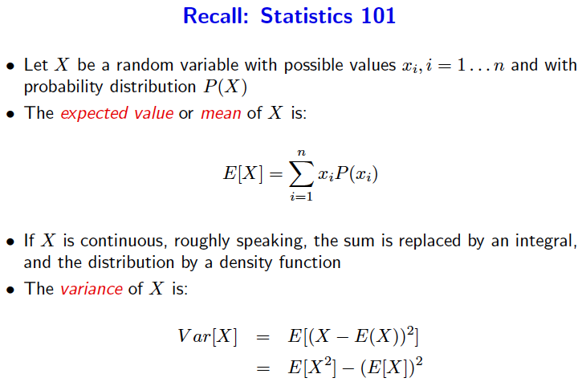
Recap : Stats

Slide 14
Estimator Performance
For an Estimator, Over the population x, if the parameter being estimated is, say “Ɵ”; and the Estimator estimates Ө̂ then
Error, e is defined as :
e(x) = Ө̂ (x) - Ɵ
MSE , Popular performance measure
MSE = Mean([Ө̂(x) - Ɵ]²) = E _{x} ([Ө̂(x) - Ɵ]²)
MSE can always be decomposed into

Slide 15
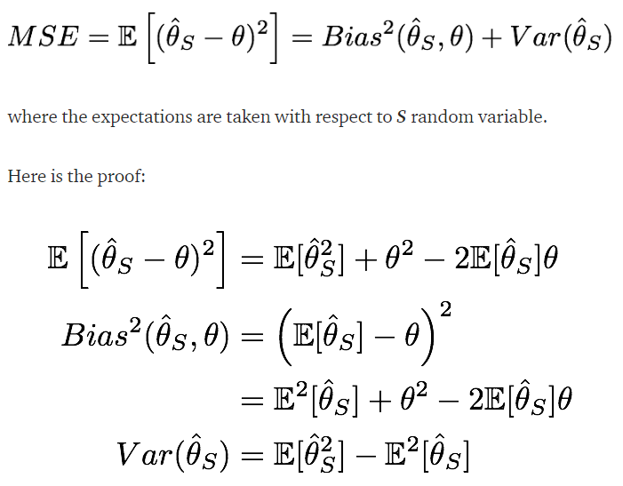
MSE

Slide 16
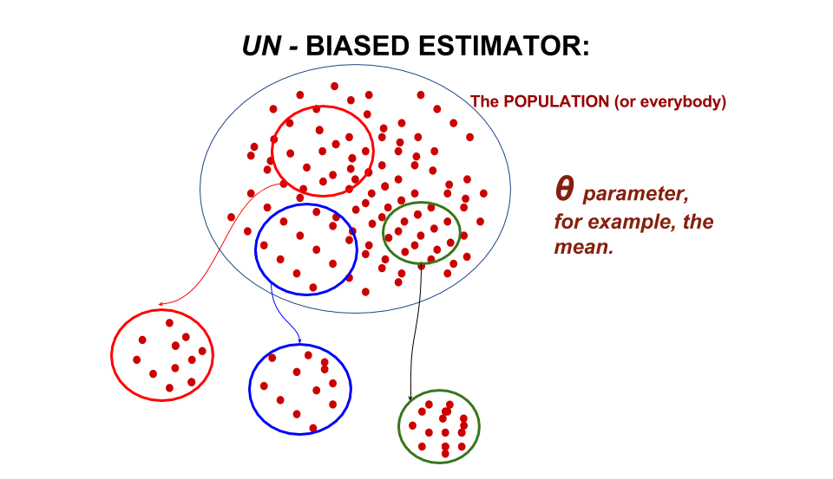
Estimator Attributes - Bias
Bias : English - Prejudice; inclination one way or the other
Bias = Deviation of the true parameter value from Expected value of the estimate
B(Ө̂ ) = E [Ө̂ ] - Ɵ
Bias can also be interpreted as the expected value of the error. Why ??
What is desired in an estimator ?

Slide 17
Estimator Attributes - Variance
Variance : English : Spread in values
Variance (Ө̂ ) = Expected value of squared sampling deviations
Variance (Ө̂ ) = E[(Ө̂̂ - E[Ө̂ ])²]
Indicates how far, on average, the collection of estimates are from the expected value of the estimates
What is desired value of variance in an estimator ?

Slide 18
Estimator Attributes
Desirable properties of estimators are :
Minimal bias and Minimal Variance

Slide 19
Bias-Variance Analysis
Decomposes E_{out} into 2 components :
How good is the Hypothesis set H, in approximating the target function (Bias)

Slide 20
For a chosen hypothesis function “g”, learnt using given training Data D,
Let’s call the resulting E_{out} as : E_{out}(g^{D})
What is E_{out}(g^{D}) ?
It is the quantity, [g^{D} (x) – f(x)]² for all possible values of x
^{i.e} [g^{D} (x) – f(x)]² averaged over all x
Or E_{out}(g^{D}) = E_{x}[g^{D} (x) – f(x)]²
E_{out}(g^{D}) has to cover all possible training Data sets D
Hence average over all possible “D” : Evaluate E_{D}[E_{out}(g^{D})]

Slide 21
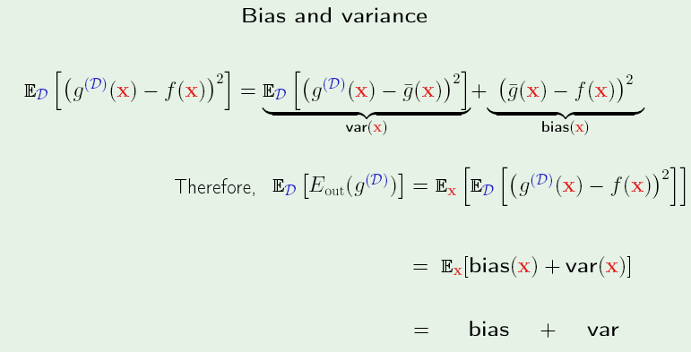
Bias - Variance

Slide 22
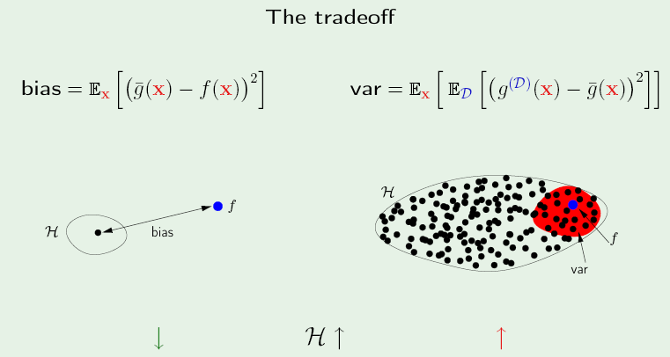
Bias - Variance
Complex Hypothesis
Simple Hypothesis

Slide 23
Simple Vs Complex H
When Hypothesis space is simple, the number of available Hypotheses to choose from is small
The variance is small but bias is large
As Hypothesis space becomes more complex, the number of available Hypotheses to choose from increases

Slide 24
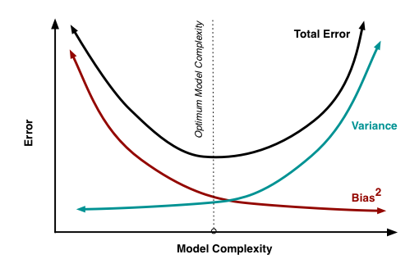
Bias-Variance-Model Complexity

Slide 25
Illustration - Tradeoff
Only has to do with Hypothesis class
Variations in the Hypothesis class
Simple Hypothesis
Complex Hypothesis
What do we infer ..???

Slide 26
Linear Models

Slide 27
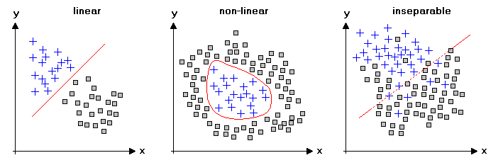
Data separability in Feature-space
Feature2
Feature2
Feature1
Feature1
Linearly separable
Non-Linearly separable
Which kind of data is easier to work with ??

Slide 28
Data separability in Feature-space
Feature2
x₂
Feature1
x₁
Linearly separable
Generic form of this linear separator ??

Slide 29
Perceptron – wiki
Perceptron – 1957 by Frank Rosenblatt
Iterative algorithm to calculate the straight line parameters (one of the earliest ML Algorithms)
Works on Linearly Separable Data
Link to Support Vector Machines (SVM)

Slide 30
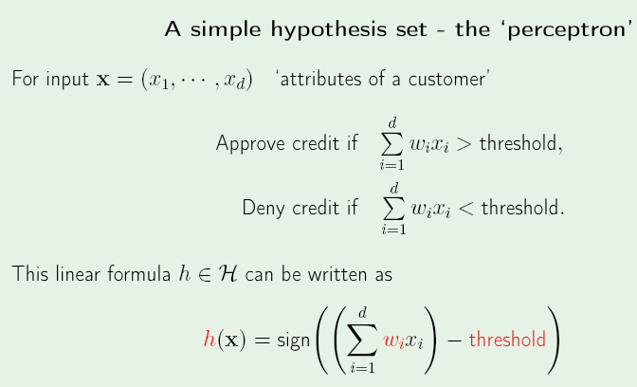
Perceptron

Slide 31
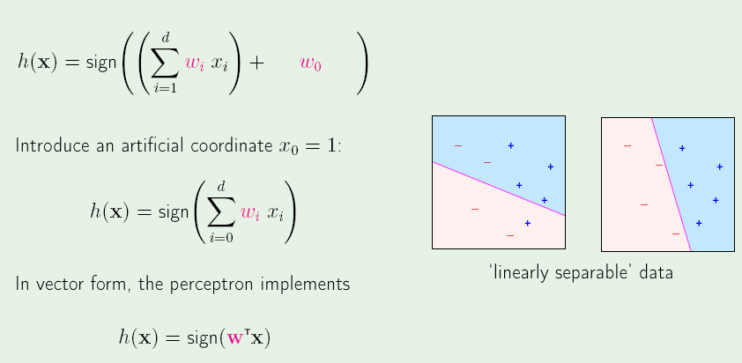

Slide 32
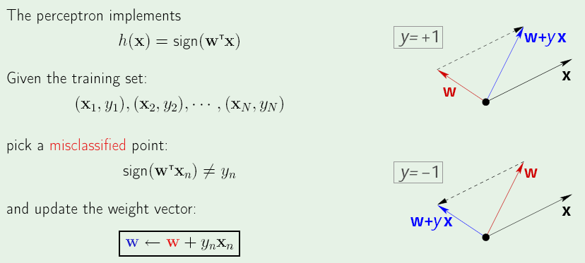
Perceptron Learning Algorithm (PLA)

Slide 33
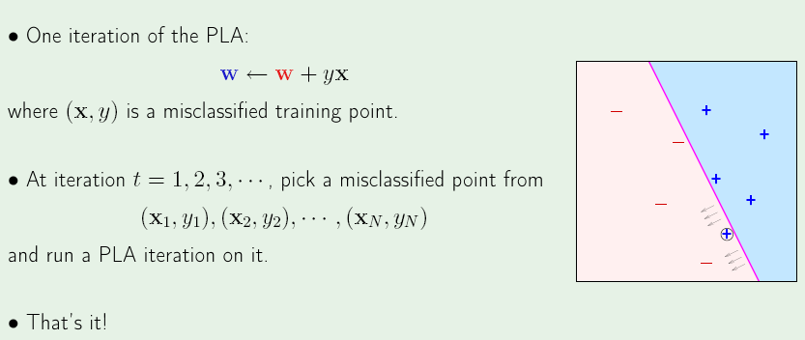
PLA Iterations

Slide 34
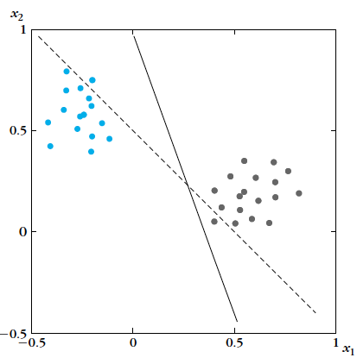
What the PLA does ?
The perceptron allows
you to move to a line
which separates the
points correctly and
therefore move to the
dark line,
1.42x₁+0.51x₂ -0.5 = 0;
This line has zero
Classification error
1

Slide 35
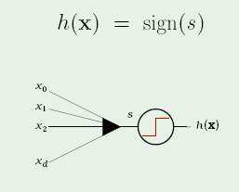
Perceptron
Works if Data is linearly Separable
What is the relation between vector w, and the linear separator ??
Realisation

Slide 36
Perceptron -Trivia
Invented in 1957 by Frank Rosenblatt
"the embryo of an electronic computer that [the Navy] expects will be able to walk, talk, see, write, reproduce itself and be conscious of its existence."
In 1969 a famous book entitled “Perceptrons” by Minsky & Papert , they showed that it was impossible for Perceptron to learn an XOR function.

Slide 37
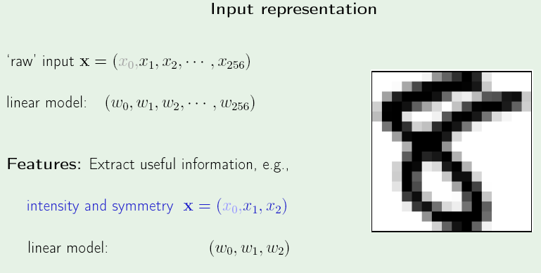
Perceptron - MNIST

Slide 38
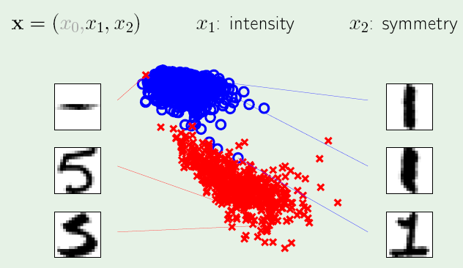
Feature Space

Slide 39
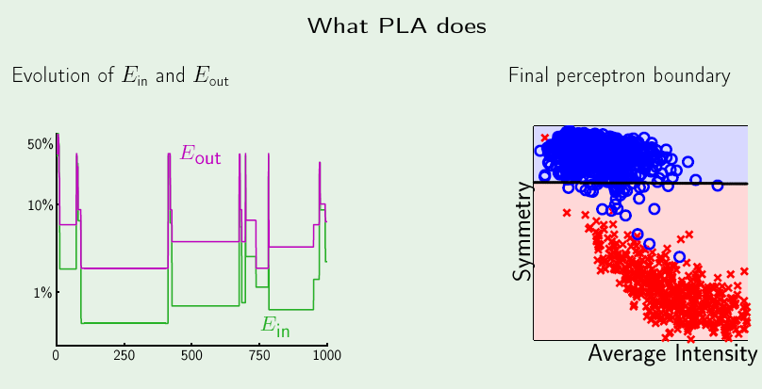
PLA - Iterations

Slide 40
Pocket - Version

Slide 41
PLA Vs Pocket

Slide 42
To Do
Perceptron on MNIST Data
Take 2 classes at a time and check if 2 confusing classes such as “1” and “7” can be classified using Perceptron
What is the cost function we are minimizing in Perceptron ?
Apply Gradient Descent to this cost function

Slide 43
Perceptron - Drawbacks
It may take too many iterations
Works only if data is linearly separable
………………

Slide 44
More Linear Models….

